Slide 1
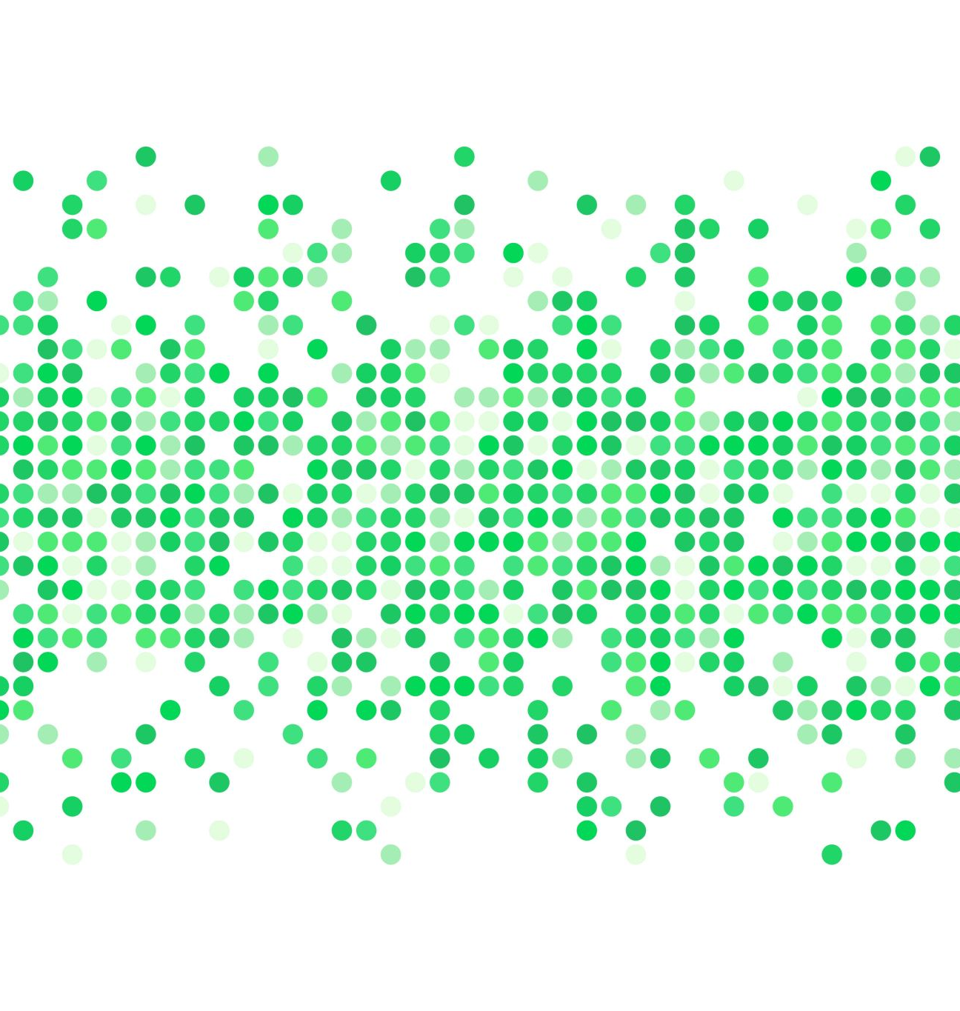

Proteomics Sample Metadata Experimental Design
Yasset Perez-Riverol PhD
Team Coordinator, PRIDE, EMBL-EBI
https://github.com/bigbio/proteomics-metadata-standard

Slide 2
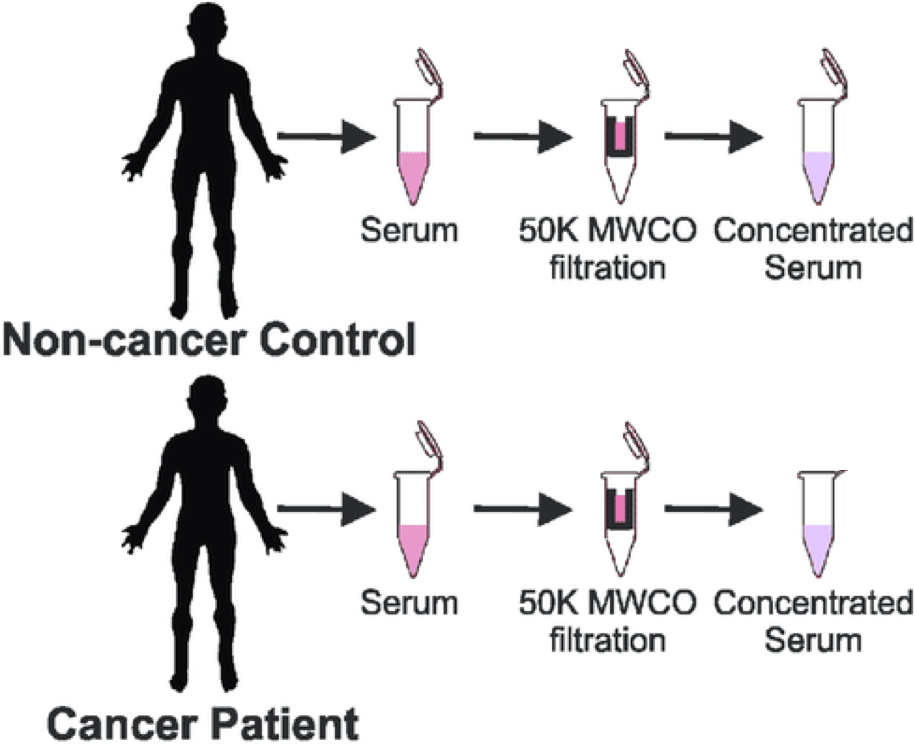
The Problem
Data Files
Instrument files
Result files
Intermediate files
Plots
config files
Dataset general description
Sample
To
Data files
PX summary file

Slide 3
Use cases and requirements
Support sample to file relations
Easy to use by submitters (manual annotation) and software tools.
Compatible with existing ProteomeXchange formats submission.px, mzTab, mzIdentML, mzML
Ontology-based

Slide 4
Why SDRF from MAGE-TAB
Support sample to file relations
Easy to use by submitters (manual annotation) and software tools.
Compatible with existing ProteomeXchange formats submission.px, mzTab, mzIdentML, mzML
Ontology-based
Well-known in the transcriptomics community allowing multi-omics studies in the future.
Existing tooling framework to validate and curate the files.
Ongoing work to represent more complex cases in like single cell RNA experiments (future of proteomics)
Tab-delimited format compatible with existing tools in Proteomics like MsStats.

Slide 5
Sample to Data format: SDRF
sample properties
data file properties
study variables
source name | characteristics[organism] | characteristics[disease] | characteristics[phenotype] | … | assay name | comment[fraction identifier] | comment[label] | comment[data file] | factor value[phenotype]
sample 1 | homo sapiens | gastric carcinoma | control |  | Run 1 | 1 | label free | fileRAW_Control_F1.raw | control
sample 2 | homo sapiens | gastric carcinoma | primary tumor |  | Run 2 | 1 | label free | fileRAW_Tumor_F1.raw | primary tumor
….
Sample properties: Attributes related for the sample (tissue, disease, etc.). The sample properties are annotated with the prefix characteristics.
Data file properties: Attributes for the assay / data file / msrun (fraction identifier, label, etc.). The data file properties are annotated with the prefix comment.
Study variable: Variables under study that should be present in the sample characteristics. The study variables are annotated with the prefix factor value
https://github.com/bigbio/proteomics-metadata-standard/

Slide 6
SDRF: experimental Design
Biological replicates should be annotated with the sample sample identifier and characteristics. biological replicate can be use as optional column.
Sample 1
Msrun 1
Sample 2
Msrun 2
.
.
.
Sample n
Msrun m
label: Type of labeling: Label free sample, TMT16
fraction identifier: identifier of the fraction 1, 2..
technical replicate (optional): identifier of the technical replicate

Slide 7
SDRF: Column and values
Column name: The column name MUST be an existing CvTerm name. Examples:
characteristics[disease] -> http://www.ebi.ac.uk/efo/EFO_0000408
characteristics[compound] -> http://purl.obolibrary.org/obo/NCIT_C43366
Values: The values of each column + sample can be:
free text: Name corresponding to OLS term. For example:
Homo sapiens
HCC1576
CvTerm URI: the URI of the corresponding CVTerm.
http://purl.obolibrary.org/obo/NCBITaxon_9606
http://www.ebi.ac.uk/efo/EFO_0006429
Complex key-value pairs: Some values CAN be represented by key-value pairs combinations. For example post-translational modifications or Enzymes:
NT=Glu→pyro-Glu; MT=fixed; PP=Anywhere; AC=Unimod:27; TA=E
NT=Trypsin; AC=MS:1001251

Slide 8
SDRF: Key-value pairs values
Property | Key | Example | Mandatory(✅)/Optional()
Name of the modification | NT | NT=Acetylation | ✅
Database Accession | AC | AC=UNIMOD:1
Chemical Formula | CF | CF=H(2)C(2)O
Modification type | MT | MT=Fixed
Position of the modification in the polypeptide | PP | PP=Any N-term | ✅
Target Amino acid | TA | TA=S,T,Y | ✅
Monoisotopic mass | MM | MM=42.010565
NM=Glu→pyro-Glu; MT=fixed; PP=Anywhere; AC=Unimod:27; TA=E

Slide 9
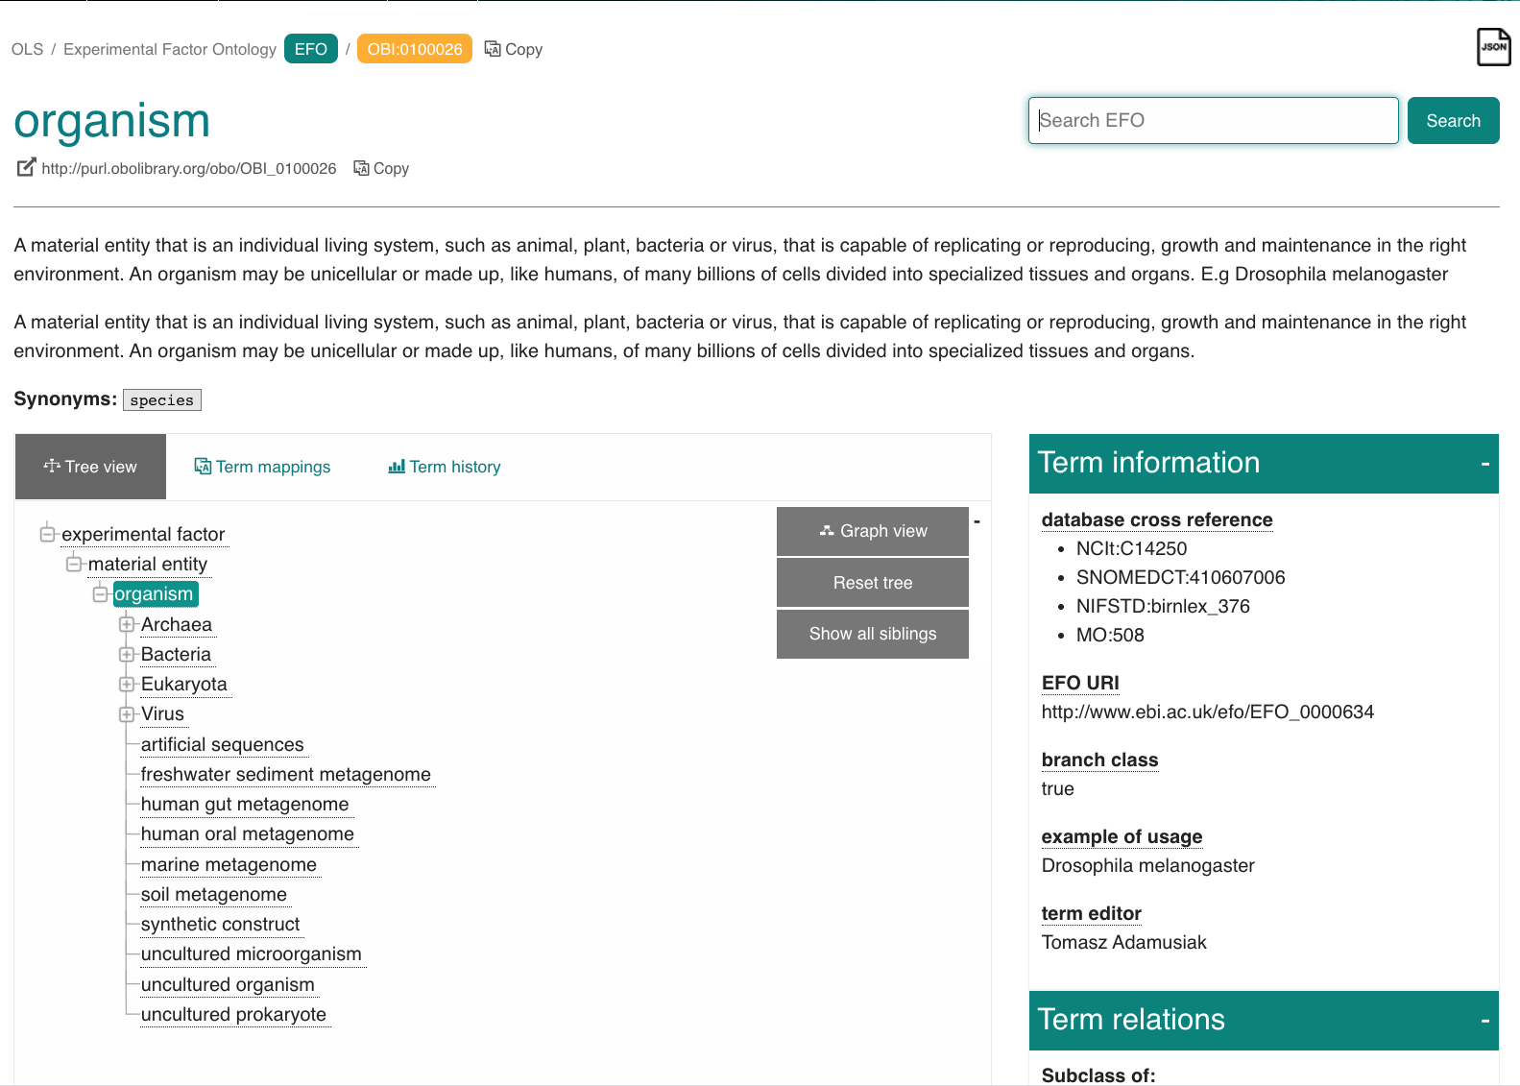
SDRF examples
source name | characteristics[organism] | characteristics[sex] | characteristics[age] | characteristics[disease] | characteristics[cell line] | characteristics[infect] | characteristics[time] | assay name | comment[label] | comment[data file] | comment[fraction identifier] | comment[technical replicate]
Sample 2 | Homo sapiens | male | 72 | colon cancer | CaCo-2 | none | 2 hour | run 1 | TMT127N | 20200219_KKL_SARS_CoV2_pool1_F1.raw | 1 | 1
Sample 3 | Homo sapiens | male | 72 | colon cancer | CaCo-2 | none | 6 hour | run 1 | TMT127C | 20200219_KKL_SARS_CoV2_pool1_F1.raw | 1 | 1
Sample 4 | Homo sapiens | male | 72 | colon cancer | CaCo-2 | none | 10 hour | run 1 | TMT128N | 20200219_KKL_SARS_CoV2_pool1_F1.raw | 1 | 1
Sample 5 | Homo sapiens | male | 72 | colon cancer | CaCo-2 | none | 24 hour | run 1 | TMT128C | 20200219_KKL_SARS_CoV2_pool1_F1.raw | 1 | 1
Sample 6 | Homo sapiens | male | 72 | colon cancer | CaCo-2 | Severe acute respiratory syndrome coronavirus 2 | 2 hour | run 1 | TMT129N | 20200219_KKL_SARS_CoV2_pool1_F1.raw | 1 | 1
Sample 7 | Homo sapiens | male | 72 | colon cancer | CaCo-2 | Severe acute respiratory syndrome coronavirus 2 | 6 hour | run 1 | TMT129C | 20200219_KKL_SARS_CoV2_pool1_F1.raw | 1 | 1
Sample 8 | Homo sapiens | male | 72 | colon cancer | CaCo-2 | Severe acute respiratory syndrome coronavirus 2 | 10 hour | run 1 | TMT130N | 20200219_KKL_SARS_CoV2_pool1_F1.raw | 1 | 1
Sample 9 | Homo sapiens | male | 72 | colon cancer | CaCo-2 | Severe acute respiratory syndrome coronavirus 2 | 24 hour | run 1 | TMT130C | 20200219_KKL_SARS_CoV2_pool1_F1.raw | 1 | 1
Sample 1 | Homo sapiens | male | 72 | colon cancer | CaCo-2 | bridge mixed pool | none | run 2 | TMT131 | 20200219_KKL_SARS_CoV2_pool1_F2.raw | 2 | 1
Sample 2 | Homo sapiens | male | 72 | colon cancer | CaCo-2 | none | 2 hour | run 2 | TMT127N | 20200219_KKL_SARS_CoV2_pool1_F2.raw | 2 | 1
Sample 3 | Homo sapiens | male | 72 | colon cancer | CaCo-2 | none | 6 hour | run 2 | TMT127C | 20200219_KKL_SARS_CoV2_pool1_F2.raw | 2 | 1
Sample 4 | Homo sapiens | male | 72 | colon cancer | CaCo-2 | none | 10 hour | run 2 | TMT128N | 20200219_KKL_SARS_CoV2_pool1_F2.raw | 2 | 1
Sample 5 | Homo sapiens | male | 72 | colon cancer | CaCo-2 | none | 24 hour | run 2 | TMT128C | 20200219_KKL_SARS_CoV2_pool1_F2.raw | 2 | 1
Column name
Column values
https://github.com/bigbio/proteomics-metadata-standard/tree/master/annotated-projects

Slide 10
SDRF: Sample templates
 | Default | Human | Vertebrates | Non-vertebrates | Plants | Cell lines
Source Name | ✅ | ✅ | ✅ | ✅ | ✅ | ✅
characteristics[organism] | ✅ | ✅ | ✅ | ✅ | ✅ | ✅
characteristics[strain/breed]
characteristics[ecotype/cultivar]
characteristics[ethnicity] |  | ✅
characteristics[age] |  | ✅
characteristics[developmental stage] |  | ✅
characteristics[sex] |  | ✅
characteristics[disease] | ✅ | ✅ | ✅ | ✅ |  | ✅
characteristics[organism part] | ✅ | ✅ | ✅ | ✅ | ✅ | ✅
characteristics[cell type] | ✅ | ✅ | ✅ | ✅ | ✅ | ✅
characteristics[individual] |  | ✅
characteristics[cell line Code] |  |  |  |  |  | ✅
comment[data file] | ✅ | ✅ | ✅ | ✅ | ✅ | ✅
comment[fraction identifier] | ✅ | ✅ | ✅ | ✅ | ✅ | ✅
comment[label] | ✅ | ✅ | ✅ | ✅ | ✅ | ✅

Slide 11
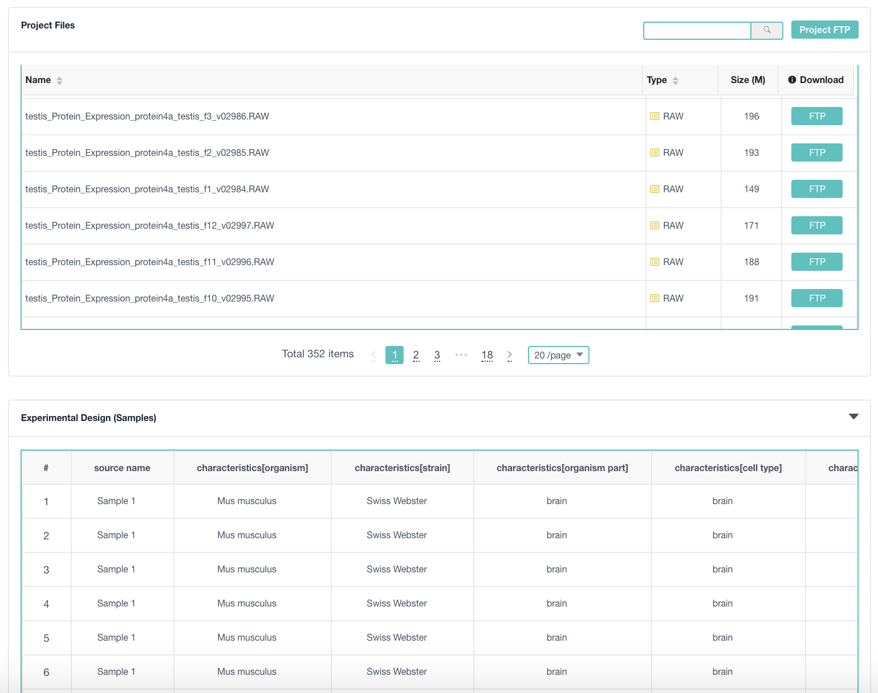
PRIDE implementation
https://www.ebi.ac.uk/pride/archive/projects/PXD019394

Slide 12
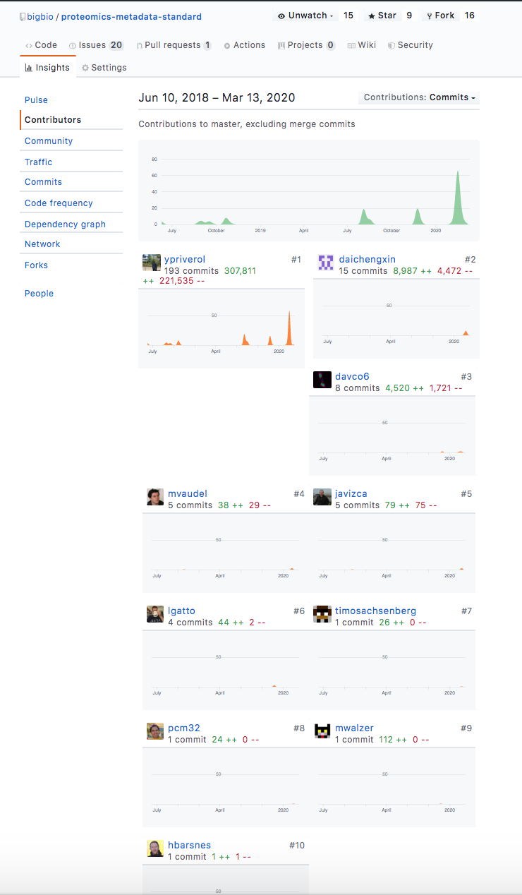
Community-oriented
Issues are discussed here: https://github.com/bigbio/proteomics-metadata-standard/issues
Examples: https://github.com/bigbio/proteomics-metadata-standard/tree/master/annotated-projects
CI validation of the files using Cirecle-CI for PRs.
parse_sdrf validate-sdrf --sdrf_file {here_the_path_to_sdrf_file}

Slide 13
- Pick a project for the PRIDE database (https://www.ebi.ac.uk/pride/archive/) - Create an issue in Github to let the community knows that you are annotating a project (https://github.com/bigbio/proteomics-metadata-standard/issues) - Annotate the project in your machine. Then you can provide the final SDRF doing a Pull Request to the main repo or upload the file annotated in your issue.
supported by:

